Slide 1

Link Spam
Section 5.4 ~ 5.5
Presented by Dere Roshidat Oluwabukola
Student Number: 246515
Distributed Network and System Lab
Department of Artificial Intelligence Convergence
Chonnam National University

Slide 2
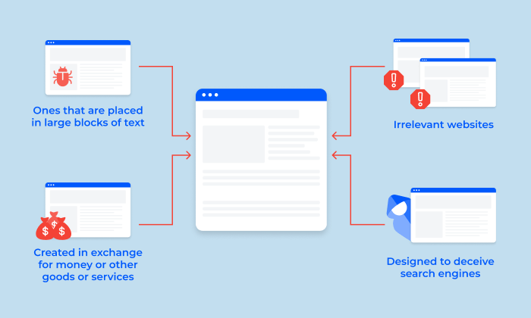
5.4 Link Spam
Link spam is a technique that is used by spammers to artificially increase the pagerank of a page.

Slide 3
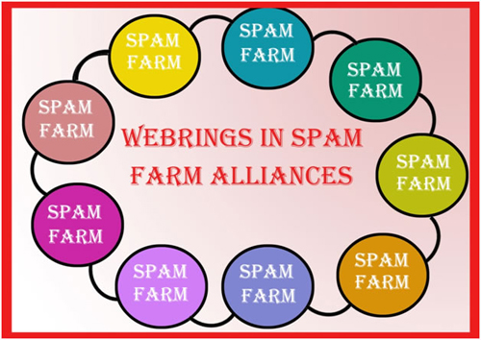
5.4.1 Architecture of a Spam Farm
Sparm farm is a collection of pages whose purpose is to increase the PageRank of a page or pages.
Web classification:
Inaccessible pages
Accessible pages
Own pages

Slide 4
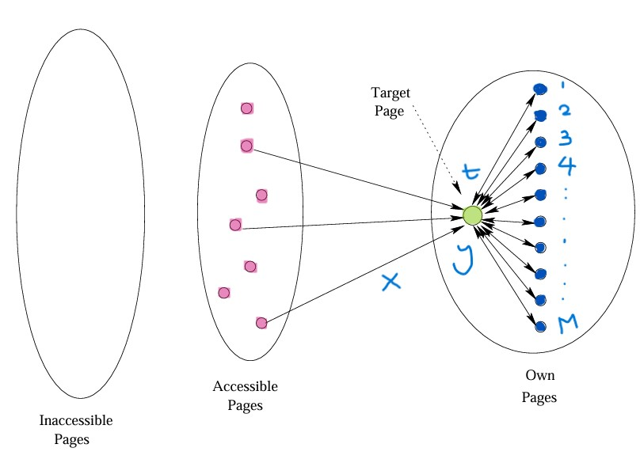
5.4.2 Analysis of a Spam Farm
t = target page
x = PageRank of accessible pages
y = PageRank of target page t
n = pages on the web
M= number of spammer pages
c= constant
Rank of each farm page = βy/M + (1-β)/n
y= x /1-β² + c(M/n)
Where c = β / 1+β

Slide 5
Example
β = 0.85
y= x/1-β² + c(M/n)
Where c = β / 1+β
Therefore,
c= 0.85 / 1+0.85
=0.46
x/1-β² = 1/1-0.85² = 3.6

Slide 6
5.4.3 Combating Link Spam
The two approaches involved in eliminating the link spam are;
To search for the structures like spam farms and eliminate those pages from the index.
To eliminate the link spam that does not rely on locating the spam farms.
Methods of automatically reducing the link spam
TrustRank
Spam Mass

Slide 7
5.4.4 TrustRank
TrustRank is a topic-sensitive PageRank with a teleport set to a trusted set of web pages.
TrustRank assigns higher scores to pages connected to the network of trusted websites, while diminishing the impact of pages linked primarily from spam farms

Slide 8
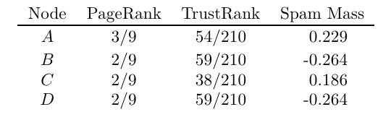
5.4.5 Spam Mass
This is a method for measuring the extent of link spam on a website. It involves calculating the difference between the PageRank of a page and its TrustRank.
A significant difference indicates a high likelihood of link spam. This technique helps in identifying and mitigating the impact of spammy links on search engine rankings.
Spam mass = x / PageRank
x = (PageRank-TrustRank)
Node A = 3/9 -(54/210) = 8/105
(8/105) / (3/9) = 0.229

Slide 9
5.5 Hubs and Authorities
The hubs and authorities algorithm, also known as HITS (Hyperlink-Induced Topic Search), was proposed shortly after PageRank.
HITS is intended to rank the responses to a specific search query during query processing.
HITS can also be applied to analyze the entire web

Slide 10
5.5.1 The Intuition Behind HITS
It describes how the algorithm identifies two types of web pages: hubs and authorities.
Hubs are pages that link to many other pages
Authorities are pages that are linked to by many hubs.
The mutual reinforcement relationship between hubs and authorities, where a good hub points to many good authorities, and a good authority is pointed to by many good hubs. This relationship helps in ranking web pages based on their relevance and importance.

Slide 11
5.5.1 The Intuition Behind HITS
Example
A typical department at a university maintains a Web page listing all the courses offered by the department, with links to a page for each course, telling about the course– the instructor, the text, an outline of the course content, and so on. If you want to know about a certain course, you need the page for that course; the departmental course list will not do.
Therefore, the course page is an authority for that course.
If you want to find out what courses the department is offering, it is not helpful to search for each courses’ page; you need the page with the course list first. This is the hub for all course information.

Slide 12
5.5.2 Formalizing Hubbiness and Authority
Hubbiness of a page is proportional to the sum of the authorities of the pages it links to, represented by the equation h = λLa, where h is a vector of hubbiness scores, a is a vector of authority scores, and λ is a scaling constant.
The authority of a page is defined as proportional to the sum of the hubbinesses of the pages linking to it, expressed as a = μLTh, where LT is the transpose of the link matrix and μ is another scaling constant.

Slide 13
Thank You for Listening

